Slide 1

HIMACHAL PRADESH TECHNICAL UNIVERSITY
An Industrial Training Presentation
for the partially fulfillment of
Four Month Industrial Training
on
SUBMITTED BY:
SWAPNIL KOUNDAL

Slide 2
My project
CAMPUS AREA
NETWORK MANAGMENT

Slide 3
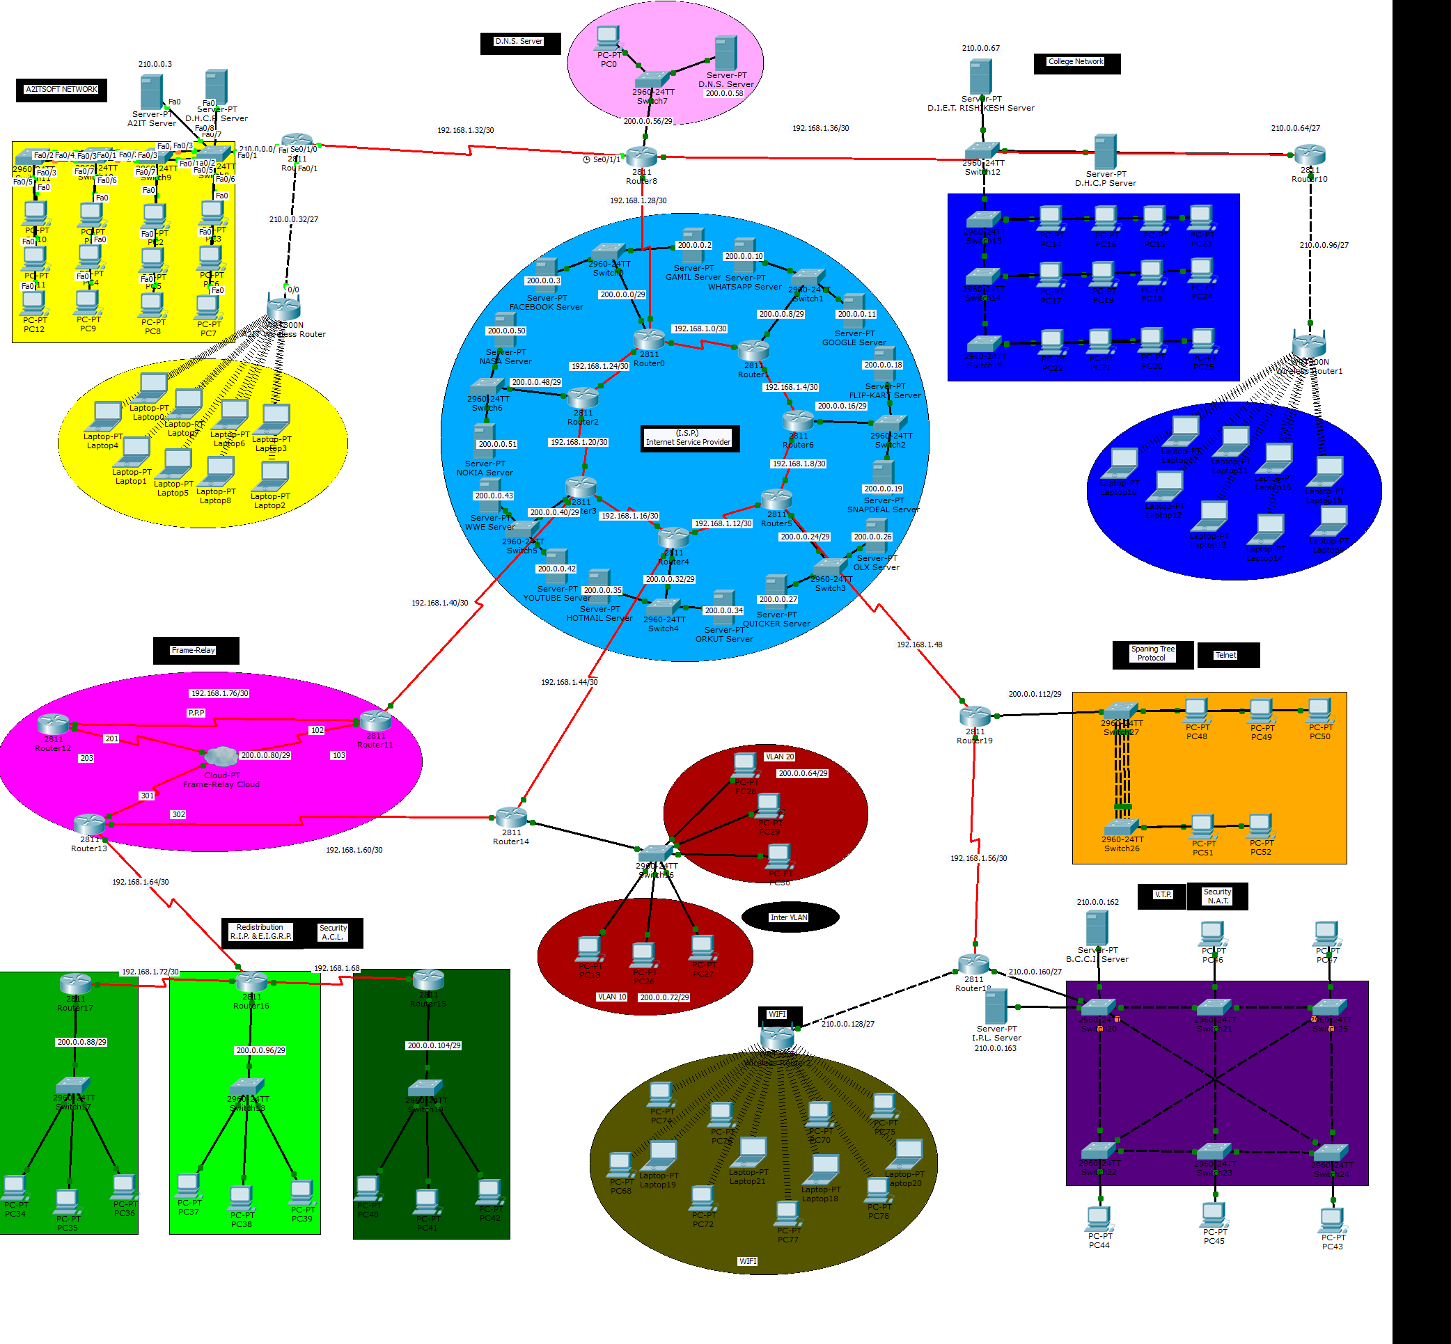
CAMPUS AREA DESIGN

Slide 4
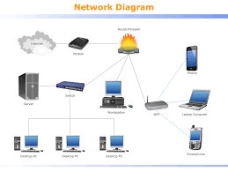


Slide 5
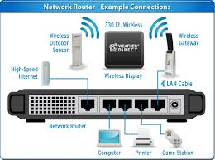
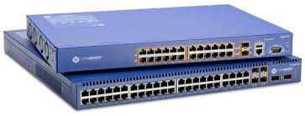
HARDWARE DEVICES

Slide 6
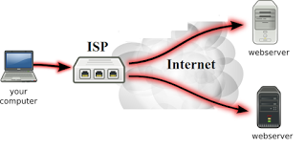
ISP
It stand for internet service provider.
ISP is an organization that provides services for accessing and using the internet.
To provide the internet services, ISP used different different technologies. Technologies may be computer modem via telephone lines, television cable, fiber optics etc .
Isp is also called IAP(internet access providers)

Slide 7
ISP CONT…
ISPs connect to one another by forming backbones, which is another way of saying a main highway of communications. Backbones usually consist of satellite, copper wire, or even fiber-optic media.
SATTELITE:-
Customers who live in remote locations, such as farms, deserts, and mountainous areas, may require a satellite Internet service. This involves transmitting and receiving data from a satellite orbiting about 22,000 miles above the earth. Although satellite communication is not as fast as other mediums, it does provide flexibility.
These satellite terminals can also be used when setting up natural disaster recovery centers.

Slide 8
FIBER OPTICS:-
Fiber optics, or fiber, is a transmission medium used to transmit light instead of electrical voltage, like copper. The great thing about fiber is that it transmits Internet traffic at the speed of light!
Fiber has great qualities, such as being very reliable unlike copper.
COPPER CABLES:-
ISPs will more likely supply home users with a copper medium, such as that used for DSL or cable broadband. This works by sending electrical pulses through a copper wire. Broadband is cheap and provides excellent Internet service to the home user.

Slide 9
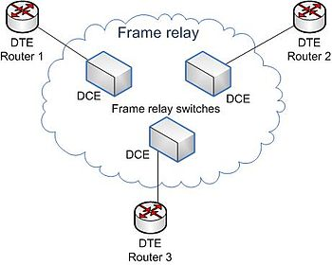
FRAME RELAY
Frame relay is a packet switched technology which is used to share bandwidth and speed of internet between routers .
Frame relay switches take their decisions based on DLCI(Data link connection identifiers).
Frame Relay operates at the physical and data link layers of the OSI reference model.
In frame relay we used inversed ARP to resolve IP address to DLCI.

Slide 10
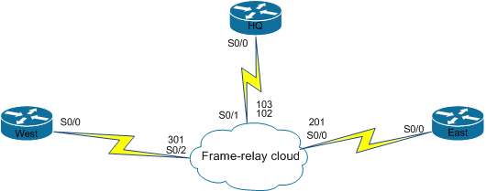
FRAME RELAY CLOUD
Frame relay cloud:- frame relay cloud is the combination of the routers and hundred of switches.
We can not buy frame relay cloud, we can only take services from them.

Slide 11
IP ADDRESS
Ip address is a unique address that identifies a device on the internet or a local network.
It is a unique string of numbers separated by dots that identifies each computer using the internet protocol to communicate over a network.
Types of ip address :-
Ipv6
Ipv4

Slide 12
Ipv4 and ipv6
Ipv4 address consist of four sets of numbers from 0-255,separated by three dots.
Ipv4 uses a 32 –bit address.
Its range from 0-255.
There are three classes of IPV4 address:-
Class A (1-126)
Class B (128-191)
Class C (192-223)
The ipv6 address consist eight sets of four hexadecimal digits and uses colons to separate each block.
Ipv6 is a 128-bit address.
IPv6 allows more users and devices to communicate on the Internet by using bigger numbers to create IP addresses. IPv6 is intended to replace IPv4.

Slide 13
IP ROUTING
DEFINITION:-
IP routing is a process of transporting data from source to destination on a determine path across two or more networks.
IP routing provides the best path for reaching the destination device.
TYPES OF IP ROUTING:-
Static routing
Next hop IP or via
outbound or exit interface
Dynamic routing
RIPV2
EIGRP
OSPF

Slide 14
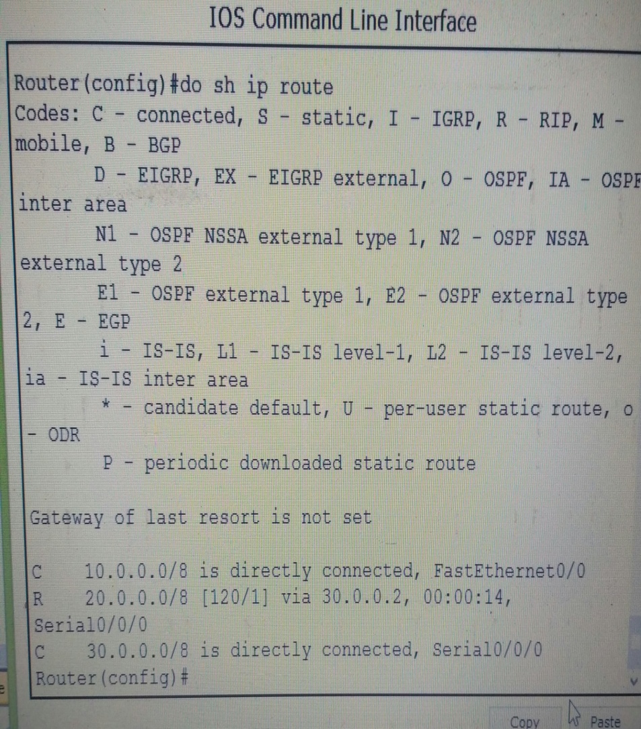
RIP
It stands for routing information protocol.
Rip is distance vector protocol.
Each RIP router transmitted full updates every 30 seconds
Maximum hop in RIP is 15.
The administrative distance(AD) value of RIP is 120.
RIP uses the User Datagram Protocol (UDP) as its transport protocol

Slide 15
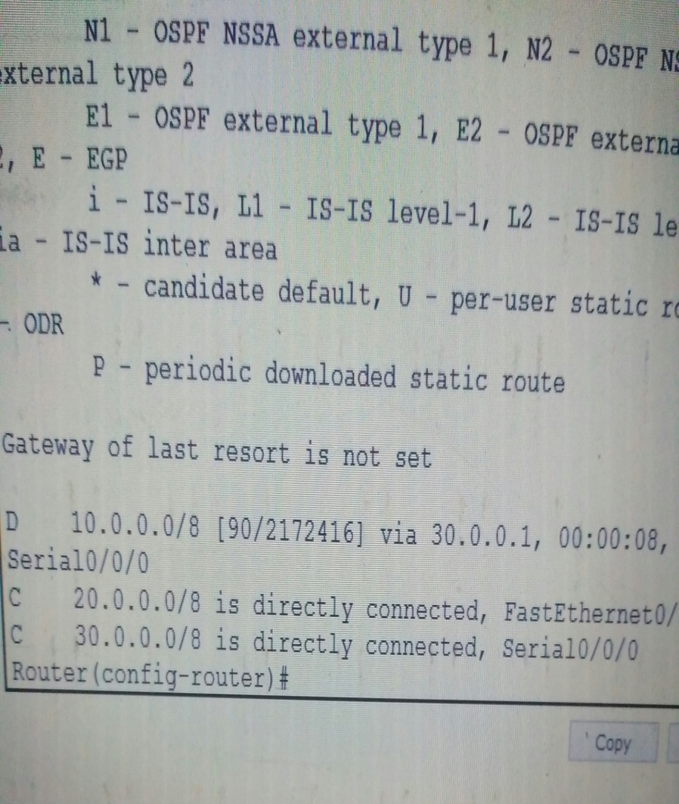
EIGRP
It stands for enhanced interior gateway protocol. EIGRP is hybrid and classfull routing protocol.
Metric of EIGRP are bandwidth, delay, load, reliability, and MTU.
In EIGRP we used DUAL algorithm and Multicast address of eigrp is 224.0.0.10.
Maximum hops in EIGRP is 255 and hello and hold time in EIGRP is 5 and 15.
AD value of EIGRP is 90.

Slide 16
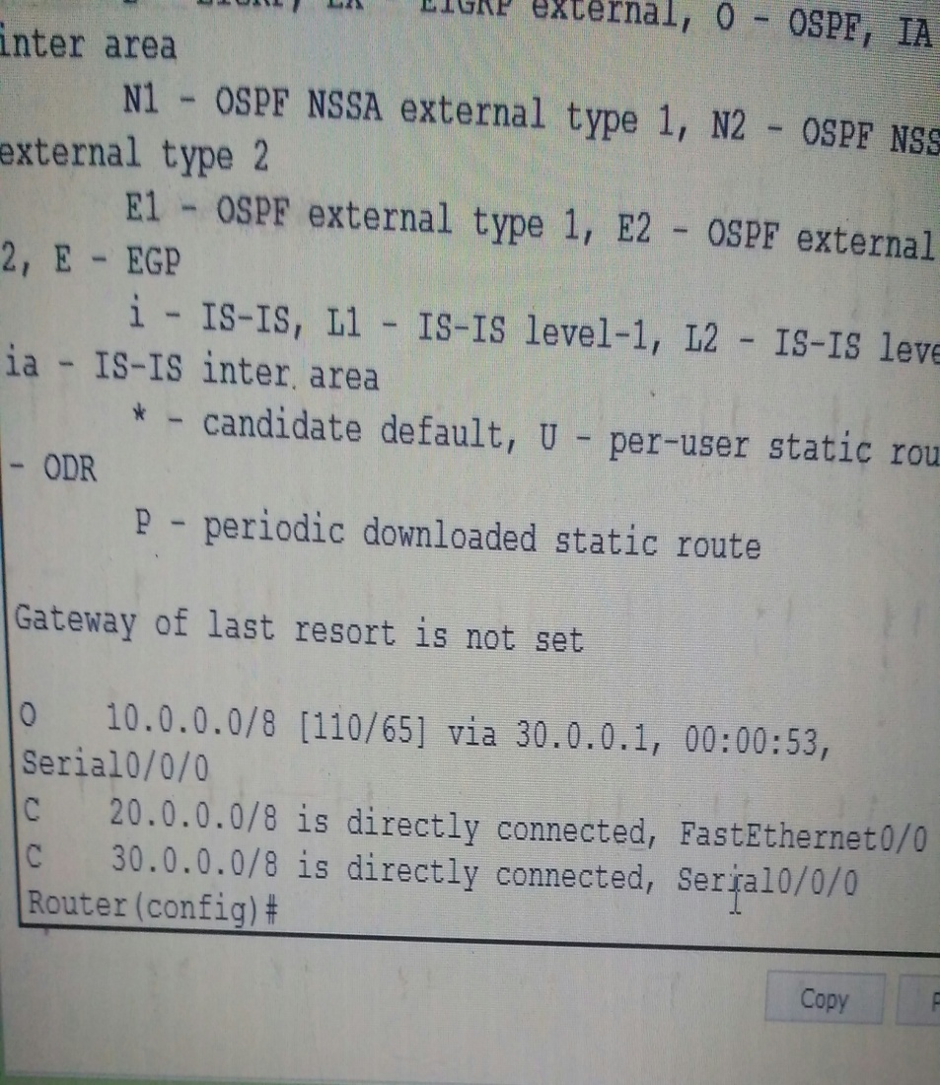
OSPF
It is also called linked state routing protocol. OSPF support VLSM/ classless.
OSPF most widely used IGP( interior gateway protocol).
OSPF use link state algorithim. And metric of OSPF is cost.
OSPF have two multicast address:-
224.0.0.5- This address send to all shotest path router.
224.0.0.6-All designated routers)

Slide 17
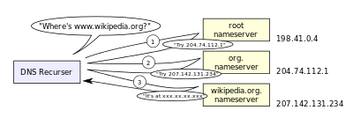
DNS
Domain Name System (or Service or Server), an Internet service that translates domain names into IP addresses and vice versa. Because domain names are alphabetic, they're easier to remember.

Slide 18
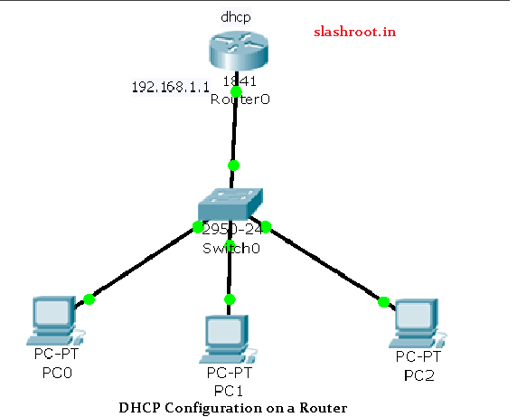
DHCP
DHCP provide the IP address to the network host.
Router as a DHCP server:-DHCP hold the information about available IP address and related configuration information.

Slide 19
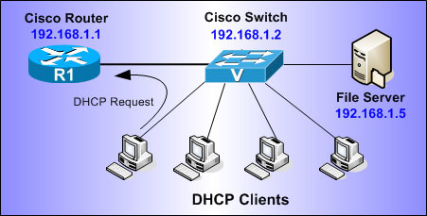
DHCP
Router as a DHCP client:-a computer that get its IP configuration information by using DHCP.

Slide 20
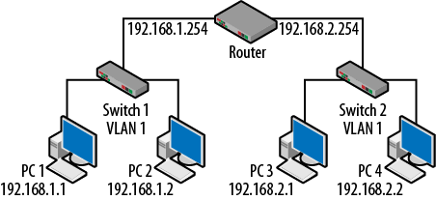
VLAN
VLAN is a logical grouping of networking devices. When we create a VLAN we actually break a large broadcast domain in smaller broadcast domain.
Consider VLAN as a subnet. Two different subnet can not communicate with each other without router, Different VLAN also requires router to communicate.
Range of the VLAN is from 1 to 1005.

Slide 21
THNAK YOU

